Slide 1
SEATS

Slide 2
public Flight (int rows, int cols)
{
seats = new Seat[rows*cols];
Date today = new Date();
int i = 0;
this.rows = rows; //6
this.cols = cols; //4
// instantiate an array of Seat objects
for (int row=1; row<=rows; row++)
for(int col=1; col<=cols; col++)
{
seats[i] = new Seat(row, col);
i++;
} // endfor
// endfor
freeSeats = rows*cols; reservedSeats = 0; bookedSeats = 0;
today = new Date();
SimpleDateFormat df1 = new SimpleDateFormat( "dd-MM-yy" );
date = df1.format(today);
}
Flight aFlight = new Flight(6, 4); //from the driver class
Needs further explanation

Slide 3
for (int row=1; row<=rows; row++)
for(int col=1; col<=cols; col++)
{
seats[i] = new Seat(row, col);
i++;
} // endfor
// endfor
Row and col are initialised to 1
Type casting
public Seat(int row, int col)
{
// convert column value
// to ASCII equivalent
String colStr = "";
col = col +64;
char colChar = (char)col;
seatNo = Integer.toString(row);
seatNo = seatNo +colChar;
currentStatus = FREE;
seatPrice = 100.0F;
seatTakings = 0.0F;
}
ASCII VALUES
A=65
B=66
C=67
D=68

Slide 4
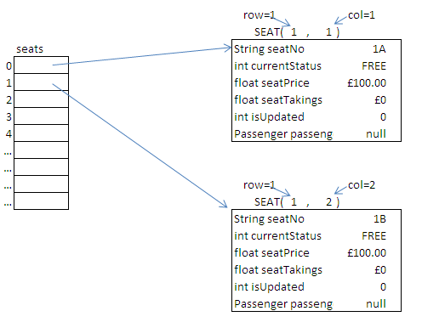
this.rows = rows; //6
this.cols = cols; //4
for (int row=1; row<=rows; row++)
for(int col=1; col<=cols; col++)
{
seats[i] = new Seat(row, col);
i++;
} // endfor
// endfor

Slide 5
aFlight.setFlightDetails("S345", "GLA","SYY");
public void setFlightDetails(String fltNo, String dep, String arr)
{
flightNumber = fltNo;
departure = dep;
arrival = arr;
}

Slide 6
public void displaySeatingPlan()
{
int i = 0;
int row = 1;
System.out.println("\n\t\t\t AB CD");
System.out.println("\t\t\t -----");
for (int j=1; j<=rows; j++)
{
System.out.print("\t\t\t"+row+" - ");
row++;
for (int k=1; k <=cols; k++)
{
if (k == 3)
System.out.print(" ");
// endif
if (k % 4 == 0)
System.out.println(seats[i].getStatus());
else
System.out.print(seats[i].getStatus());
// endif
i++;
} // endfor
}// endfor
}
aFlight.displaySeatingPlan();
this.rows = rows; //6
this.cols = cols; //4

Slide 7
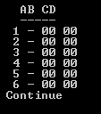
System.out.println("\n\t\t\t AB CD");
System.out.println("\t\t\t -----");
for (int j=1; j<=rows; j++)
{
System.out.print("\t\t\t"+row+" - ");
row++;
for (int k=1; k <=cols; k++)
{
if (k == 3)
System.out.print(" ");
// endif
if (k % 4 == 0)
System.out.println(seats[i].getStatus());
else
System.out.print(seats[i].getStatus());
// endif
i++;
} // endfor
}// endfor
public int getStatus()
{
return currentStatus;
}
this.rows = rows; //6
this.cols = cols; //4

Slide 8
Booking A SEAT

Slide 9
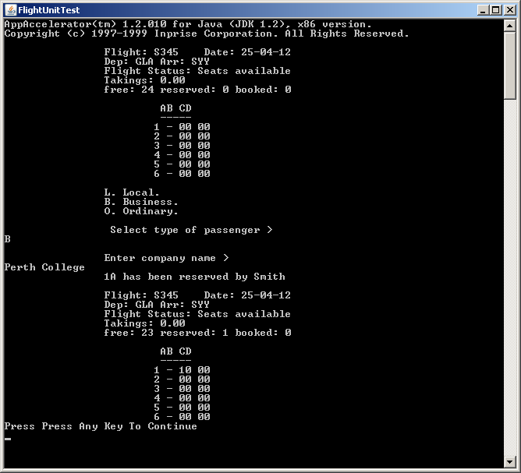
Indication that seat has been
booked
How Does it work?

Slide 10
aFlight.updateSeat("1B", "Brown", 2);
From the driver class
Seat number
Status (0 – FREE, 1 – RESERVED, 2 – BOOKED)
Passenger Name
In your version the data will not be hard coded but methods asking for the seat number
For example
public String getSeat();
public String getPassengerName();
public int getStatus();

Slide 11
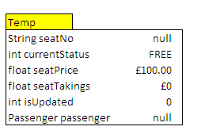
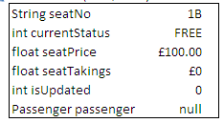
aFlight.updateSeat("1B", "Brown", 2);
public void updateSeat (String seatNo, String pName, int status) throws IOException
{
Seat temp;
temp = getSeat(seatNo); //In this case its 1B
private Seat getSeat(String searchValue)
{
int index = 0; boolean found = true;
try{
while (!(seats[index].getNo().equalsIgnoreCase(searchValue)))
{
index++;
} // endwhile
}catch (ArrayIndexOutOfBoundsException e)
{System.out.println("\n\t\tERROR - invalid seat number entered");
found = false;};
if (found==true)
return seats[index];
else
return null;
}
If seat entered equals seat nos in array seats (1 dimensional)
seats[1] =
Returns object held in element

Slide 12
public void updateSeat (String seatNo, String pName, int status) throws IOException
{
if (temp != null)
{
temp.changeSeatStatus(status, pName);
temp
seats[1] =
2,BROWN
This is an example of function overloading
(polymorphism)
There are two versions of the method changeSeatStatus. This is called function overloading. The version called depends upon the number of parameters passed to the method.
public void changeSeatStatus(int newStatus, String pName, char pType, String pInfo)
public void changeSeatStatus(int newStatus, String pName)

Slide 13
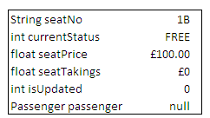
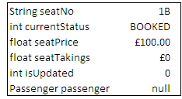
BOOKING A SEAT
2,BROWN
private static final int FREE = 0;
private static final int RESERVED = 1;
private static final int BOOKED = 2;
switch(newStatus)
…
…
case BOOKED :
switch (currentStatus)
{
// book a free seat
case FREE : currentStatus = BOOKED;
passenger = createPassenger(pName);
seatTakings += seatPrice*passenger.getDiscount();
System.out.println("\t\t"+seatNo+" has been booked by "+passenger.getName());
isUpdated = 4; // free to booked
break;
// book a reserved seat
See next slide

Slide 14
At this point you will create the passenger details. You already have the name of the passenger which you have passed to the method. After asking which type of passenger you are Local, Ordinary or Business the following code is executed…
switch (reply)
{
case 'L' :System.out.println("\n\t\tEnter place of residence > ");
passInfo = DSInput.readString();
temp = new IslandPassenger(newPassName, passInfo);
break;
case 'B' :System.out.println("\n\t\tEnter company name > ");
passInfo = DSInput.readString();
temp = new BusinessPassenger(newPassName, passInfo);
break;
case 'O' :System.out.println("Is the booking part of a promotion (Y/N)? >");
passInfo =DSInput.readString();
temp = new OrdinaryPassenger(newPassName, passInfo);
break;
} // endswitch
return temp;
In our case BROWN is a Local passenger living in Oban
temp is of type Passenger (Abstract class)

Slide 15
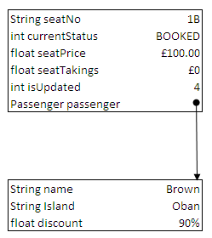
seats[1]
case BOOKED :
switch (currentStatus)
{
// book a free seat
case FREE : currentStatus = BOOKED;
passenger = createPassenger(pName);
seatTakings += seatPrice*passenger.getDiscount();
System.out.println("\t\t"+seatNo+" has been booked by "+passenger.getName());
isUpdated = 4; // free to booked
break;
// book a reserved seat

Slide 16
Hint:
When cancelling a seat you should look at the way the method
aFlight.updateSeat
aFlight.updateSeat(aFlight.getNewSeatNumber(),aFlight.getNewSeatName (), aFlight.getNewStatus ());
is called when booking a seat.
When you wish to cancel a seat you need only pass over the seat number and the new status 0 (which is FREE). If the name of the passenger is not required why not simply pass over an empty string “”
aFlight.updateSeat(aFlight.getNewSeatNumber(),"", 0);

